Slide 1
EM characterization of Switched Mode Power Supply
Manoj Gulati
IIIT-Delhi
18 Nov 2013

Slide 2
Brief Background of NILM
Idea: Infer state of appliances non-intrusively
Need:
Indoor activity sensing
Indoor localization
Individual Energy apportionment

Slide 3
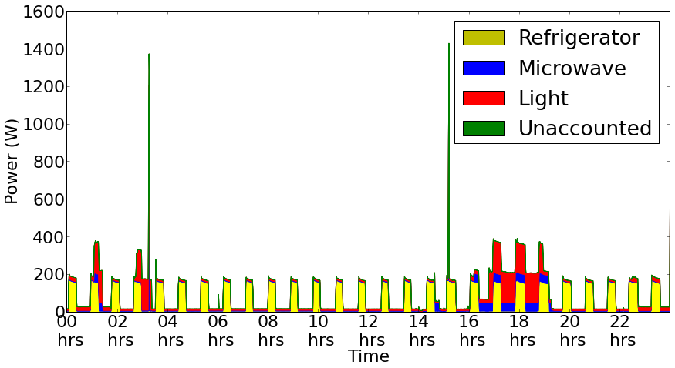
Insights in to NILM
Image taken from NILM work done at IIITD

Slide 4
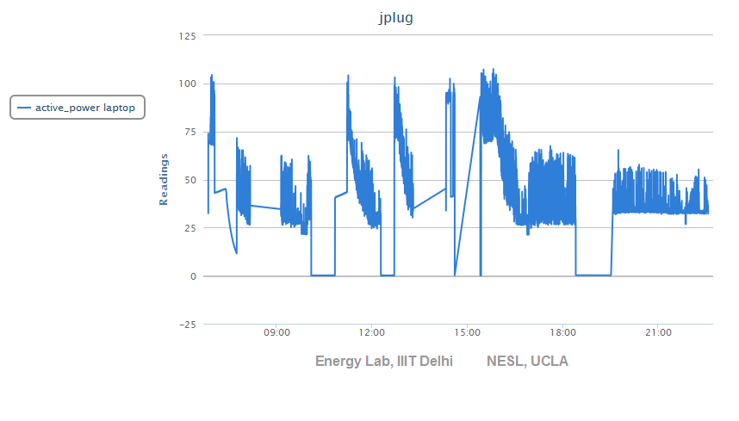
Power trace from Laptop

Slide 5
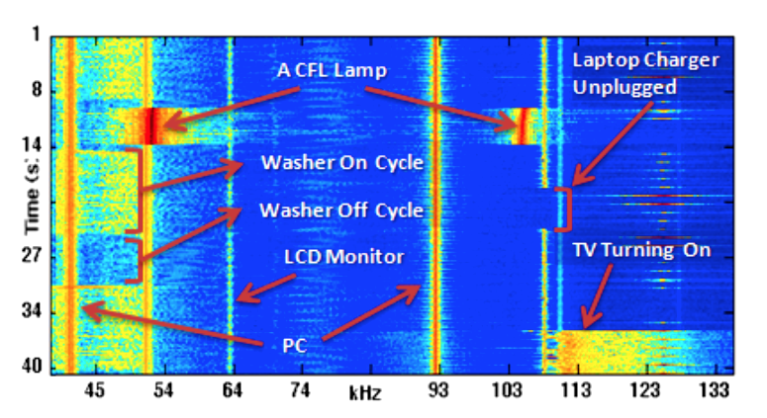
ElectriSense
ElectriSense:
Single-Point Sensing Using EMI for Electrical Event Detection and Classification in the Home

Slide 6
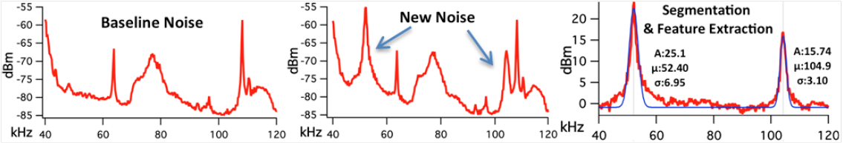
ElectriSense
Probabilistic modeling for EMI trace using Gaussian curve fitting
ElectriSense:
Single-Point Sensing Using EMI for Electrical Event Detection and Classification in the Home

Slide 7
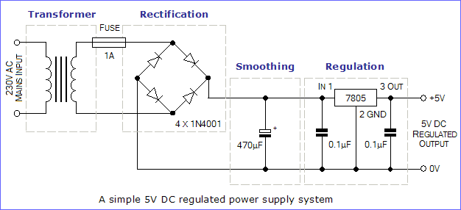
Linearly Regulated Power Supply

Slide 8
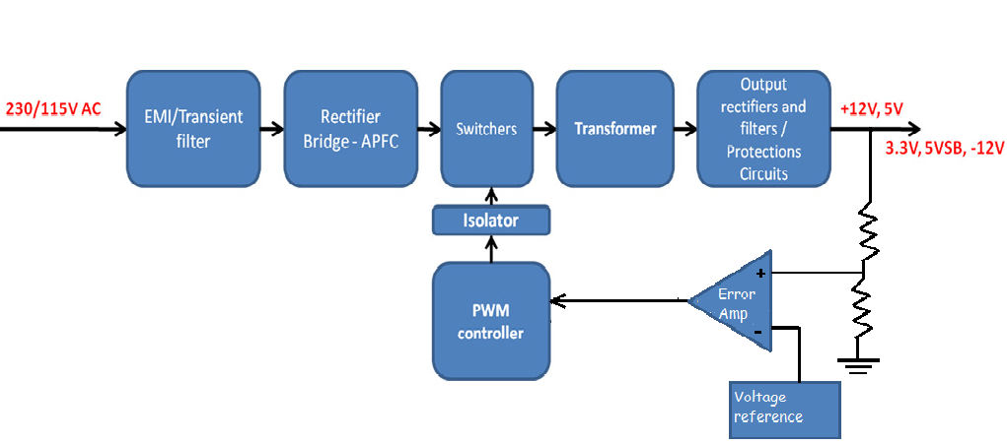
SMPS
Switched Mode Power Supply

Slide 9
Idea: EM Characterization in SMPS
Need: Modelling approaches by NILM folks fails on complex loads.
Why EMI ?
EMI signals are stable and predictable
Origin: Switching action of SMPS
Effect on Design: EMI filters and suppression req.

Slide 10
EM noise
Conducted EMI
Radiated EMI

Slide 11
EM noise propagation
Resistive (or Galvanic) coupling
Noise signal propagates through electrical connections
‘Common impedance’ can be classified as galvanic coupling
Occurs due to sharing of current paths [1] [2]
Capacitive coupling
Electric fields form the main coupling path
Inductive coupling
High frequency switching currents in Inductors
Cause strong magnetic fields at high frequencies
Occurs quite often in SMPS
Wave coupling
Noise is transmitted via Electromagnetic wave
Come in to picture at high frequencies usually in Ghz
[1] http://www.learnemc.com/tutorials/Common_Impedance_Coupling/conducted_coupling.html
[2] http://www.learnemc.com/tutorials/Current_Paths/Current_Paths.html

Slide 12
DC-DC Convertor
Buck Convertor (Step down)
Boost Convertor (Step up)
Buck Boost Convertor (Step up/down)

Slide 13
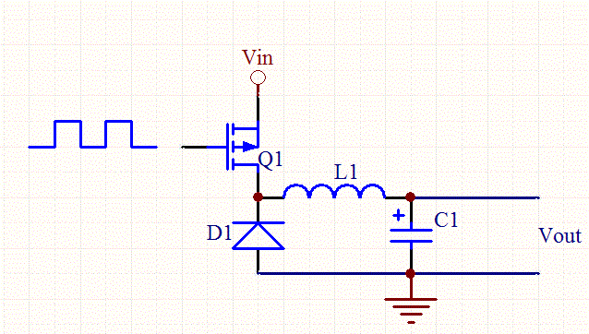
Simple Buck Regulator (Open-loop)
Image Courtesy:
http://www.daycounter.com/LabBook/BuckConverter/Buck-Converter-Equations.phtml

Slide 14
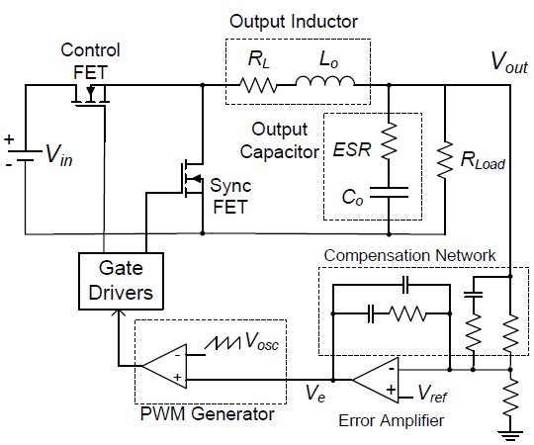
Buck Regulator (Closed-loop)
Image Courtesy:
AN: 1162 Compensator Design Procedure for Buck Converter with Voltage-Mode Error-Amplifier

Slide 15
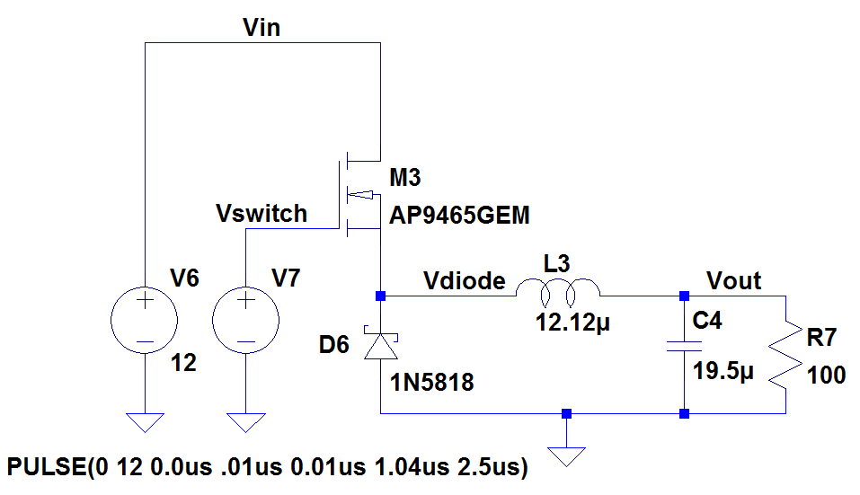
Buck Regulator

Slide 16
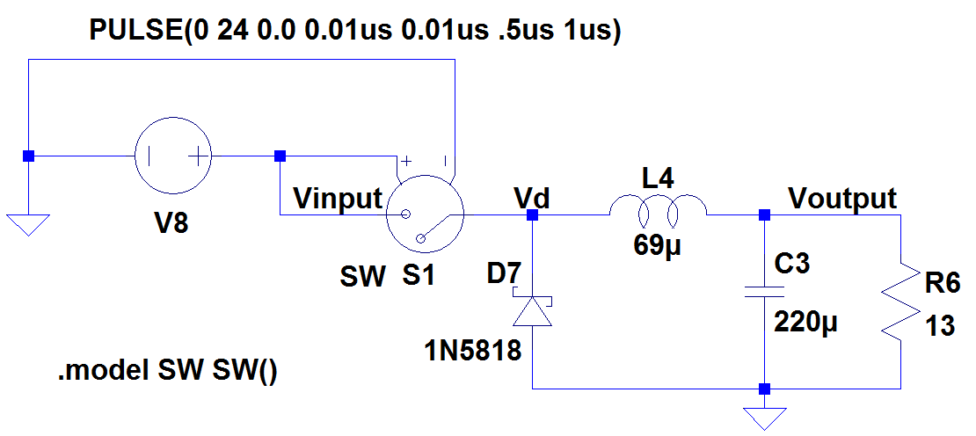
Simplified Buck Convertor

Slide 17
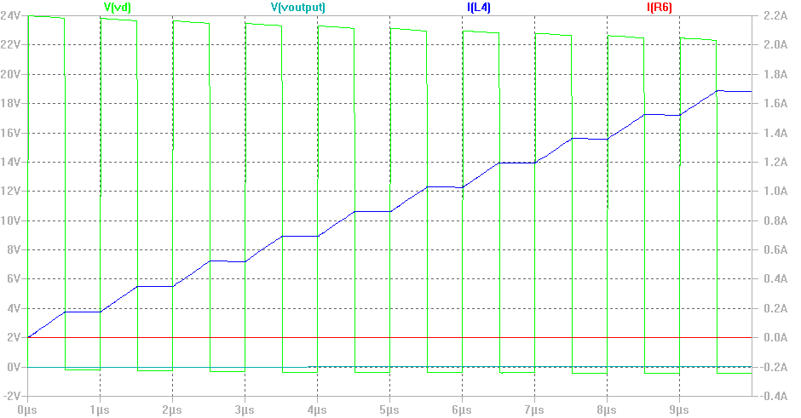
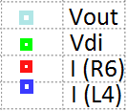
Transient Analysis

Slide 18
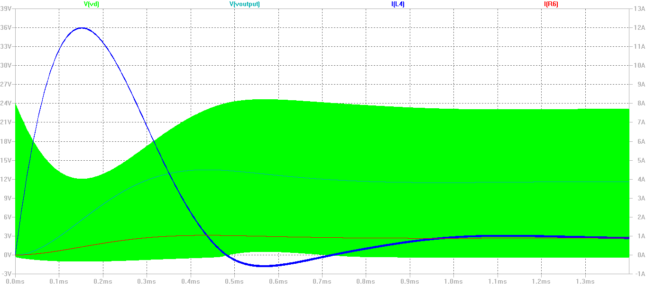
Steady State Analysis

Slide 19
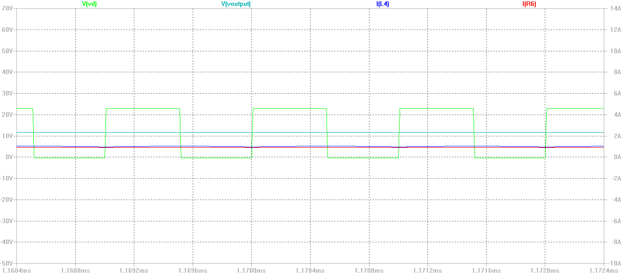
Steady State Analysis
After Zooming

Slide 20
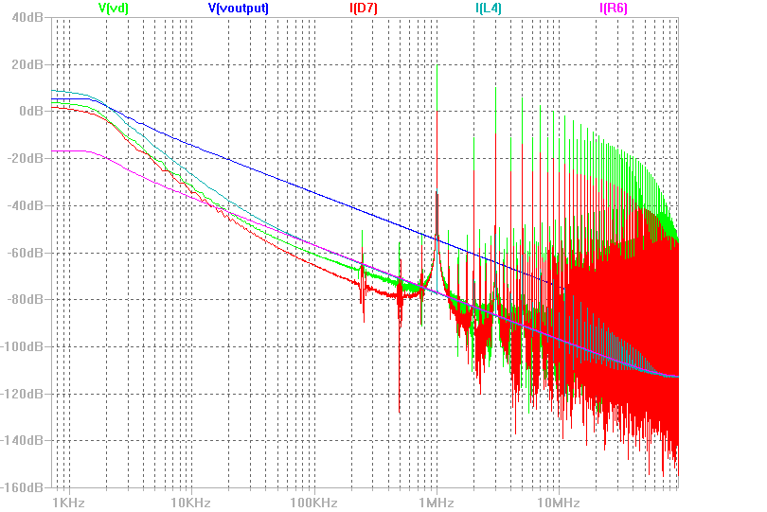
Frequency Domain Analysis

Slide 21
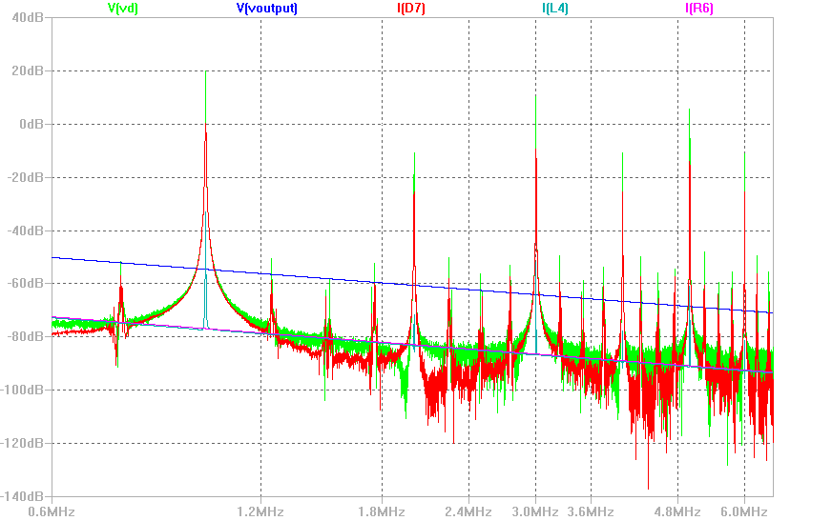
Frequency Domain Analysis
http://www.facstaff.bucknell.edu/mastascu/elessonshtml/Freq/Freq4Note11SquareWave.htm

Slide 22
Acknowledgements
Dr. Hashmi PhD EC University of Cardiff
Dr. Shobha Sundar Ram PhD EC UT Austin
Mr. Makarand Mijar Senior Design Engineer
Qualcomm, India

Slide 23
I will be working on this project in December, 13 if anyone interested to work along with me please drop a mail at manojg@iiitd.ac.in
Thanks for your concentration.
Slides available on request.

